Slide 1
GDSC MANAGERIAL

Slide 2
ACKNOWLEDGEMENT
GDSC TEAM
I would like to express my special thanks to WHOLE TEAM who gave me this golden opportunity to present this.
I came to know about so many new things while organizing this event. I also learnt how to manage things up while getting engaged to academics stuff as well.

Slide 3
TABLE OF CONTENTS
01
04
Domain Selection
Sneak Peek
02
05
Name of the event
Stages
03
06
Project Goals
Our Team

Slide 4
DOMAIN SELECTION
WEB DEVELOPMENT

Slide 5
Name of the Event and advertisement
Devjam: A jamming of developers(more precisely web developers).

Slide 6
Dates
FIRST MESSAGE 5/12
Event 11-13/12
Result Declaration: 15/12

Slide 7
Initiative
FIRST MESSAGE
Permission for the venue
Budget passing for event and advertisement

Slide 8
—GDSC
Hello developers, we’re introducing a jamming session for you. “DEVJAM”, a 3day event.

Slide 9
—GDSC
We’ll seek permission for the use of labs of AKGEC
1. Bosch lab
2.LT’s
3. Cs-It block classes

Slide 10
—GDSC
All the students are supposed to bring their own laptops if we’re allotted LT’s or Cs It classes.
No issue in case of the lab.

Slide 11
REGISTRATION PROCESS
INSTA PAGE
OFFLINE
ONLINE
Using the links provided to them in the GDSC message, they would be able to register easily.
Using insta handle also they would be able to register themselves
Separate desks would be arranged in each blocks for offline registration.

Slide 12
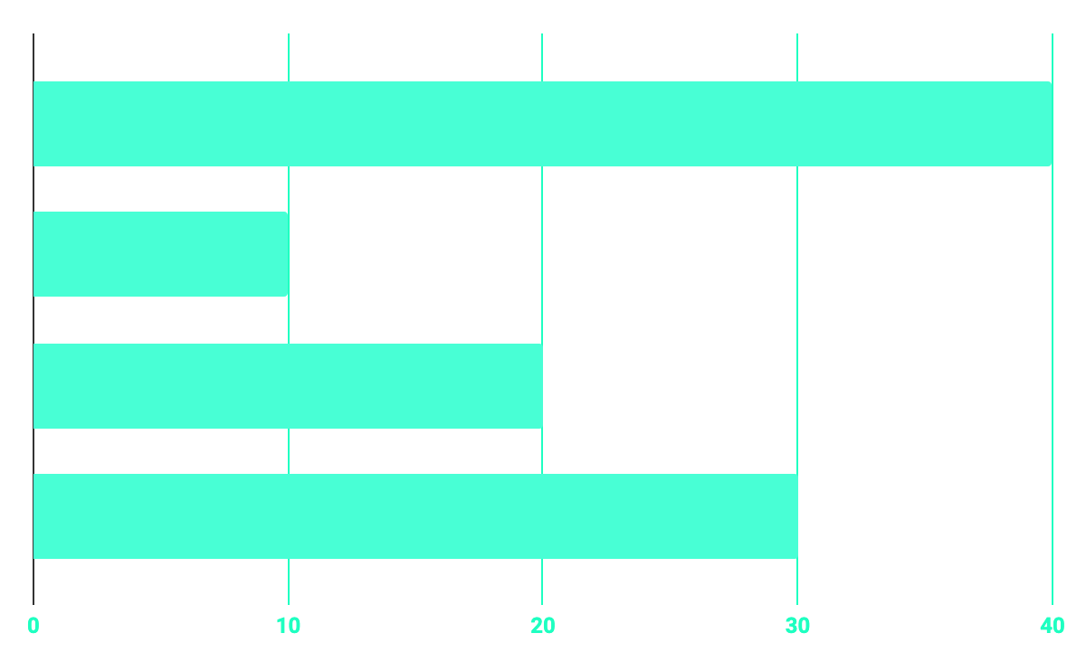
BUDGET
40%
20%
PROGRAMMING
10%
30%
DATABASE
WEB DESIGN
UX RESEARCH

Slide 13
PROJECT STAGES
DAY 2
DAY 1
DAY 3
Login Page with proper validations.
A portfolio making competition using CSS, JAVA, HTML.
Application focusing on designing.

Slide 14
OUR REQUIREMENTS.
Mainly the people having knowledge about frontend would qualify this level. They would be given a portfolio website to create. 1: Website containing their own details.
2: Website comprising of GDSC details(which can be further used as well)
3: Website of college(this can also be used).
It must contain some responsive links .
Time bounded event: We will allot almost 1 hours to them. It will be conducted from 4:30-5:30pm.

Slide 15
OUR REQUIREMENTS.
Mainly the people having knowledge about Backend would qualify this level. 1: Website containing login and signup pages
We can put some validations in passwords and login credentials.
It can also be used for GDSC members or for college.
Time bounded event: We will allot almost 1 hours to them. It will be conducted from 4:30-5:30pm.

Slide 16
OUR REQUIREMENTS.
Using web designing they would be supposed to
copy the same design.
It might include: text alignment ( May be right, left
or centre aligned)
Text colour( as same as given)
Adding a picture, clipart or any shape.
Time bounded event: We will allot almost 1 hours to them. It will be conducted from 4:30-5:30pm.

Slide 17
PERKS
badges
certificates
Cash prizes
1
2
3

Slide 18
BUDGETS.
1st day : 1000
2nd day: 1500
3rd day: 2000

Slide 19
JUDGEMENT
Completion
Time management
Accuracy

Slide 20
OUR TIMELINE
WEEK 1
Day 3
Team meeting
FINAL
ANNOUCEMENT
Week 2 3 days
WEEK 1 Day 2
advertisements
Registrations
Online and offline
Message
Event

Slide 21

That’s it for the offline event.

